Slide 1
Term Deposit dashboard
File created on: 12/4/2024 11:11:12 PM

Slide 2
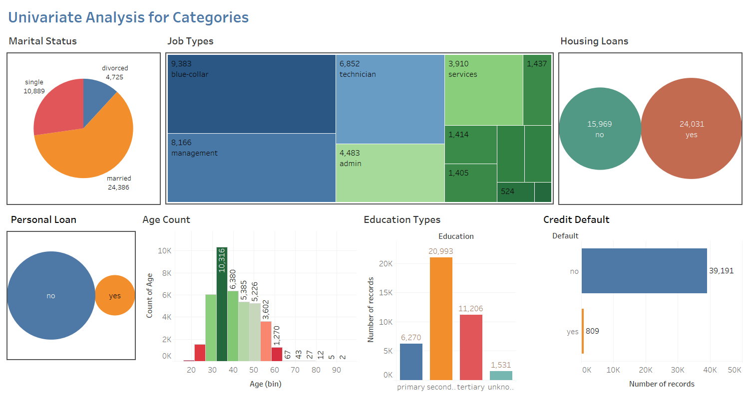

Slide 3
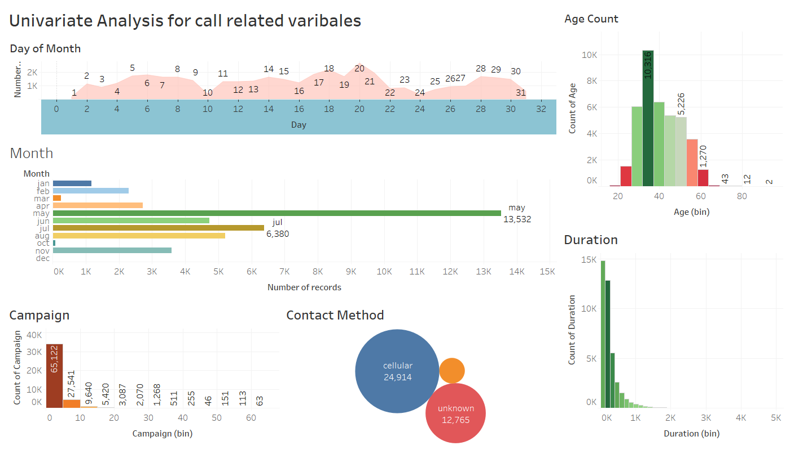

Slide 4
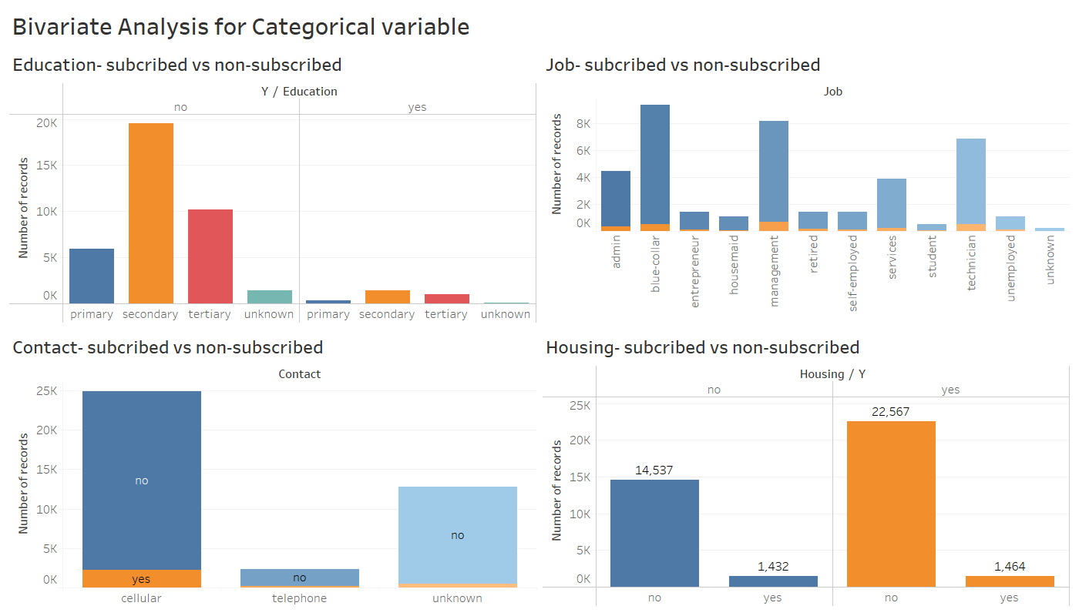

Slide 5
